Slide 1
CMSC330.2xx Day 1 - Overview
Fall 2019 Eastman

Slide 2
Study of programming languages Why What How

Slide 3
Why take PL?

Slide 4
Which is better?
i = i + l; or
i++;

Slide 5
Trick! That’s a lowercase L
i = i + l;
i++; //Easier to read?
//Faster?

Slide 6
Interviewer asks:
You know Java –
can you learn C# for us?
Your answer?

Slide 7
Can do – C# similar to Java
Know concepts, need details

Slide 8
New concepts
+/1=throws←?10000p6
What does this do?

Slide 9
New concepts
+/1=throws←?10000p6
APL 1962 Ken Iverson. Very terse vector language!
Read right to left:
• Roll 10,000 dice, store in throws, count the # of 1s.

Slide 10
Which would you use for real-time robotics – Java or C?

Slide 11
In general, C – no garbage collection to interrupt real-time execution

Slide 12
What language is this?

Slide 13
G-Code
3d printer control
Small, specialized

Slide 14
NASA Goddard Supercomputer
Which language
would you use?

Slide 15
Summary: Why take PL?
Think deeply about programs, programming
Know programming language features better
Know different categories of general purpose and specialized PLs
Learn a new one faster by comparing/contrasting to known
Choose best language for an application
Write your own language, small or large
It's interesting and fun – rich part of computer science

Slide 16
What is the study of PL?
Questions and concepts

Slide 17
Motivating question
You have to learn Scala. What questions do you ask about it before you start?

Slide 18
Is it a general purpose PL?

Slide 19
A language is Turing Complete if it can compute any function computable by Turing Machine (Turing, 1936)

Slide 20
Church-Turing thesis: If a function can be computed, it can be computed by a TM.

Slide 21
Theoretically: all general purpose PLs are equivalent. Java = C = Lisp = Scalia = Ruby

Slide 22
Theoretically: all general purpose PLs are equivalent. Java = C = Lisp = Ruby
In practice? No
Walk == Car == bike?

Slide 23
Non-Turing complete languages: G-Code JSON HTML/CSS AIML – AI Markup Lang For Turing complete need: variables, ifs, ints loops/recursion

Slide 24
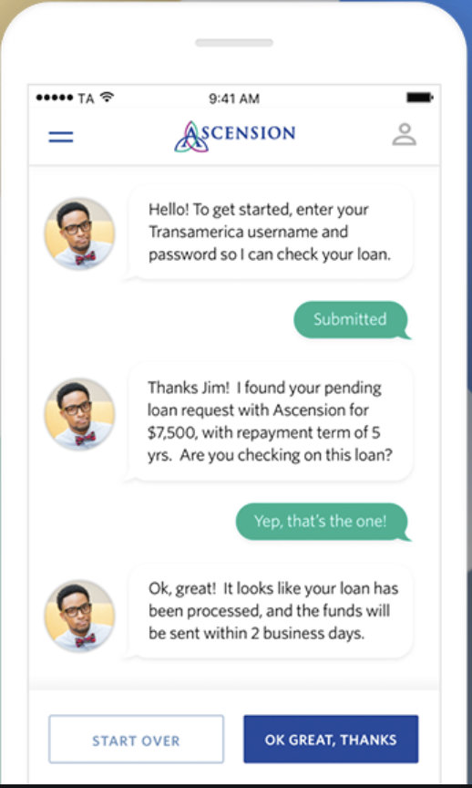
AIML – AI Markup Lang Chatterbots

Slide 25
Scala is …?

Slide 26
What paradigm is Scala?

Slide 27
Imperative vs. Declarative Paradigms

Slide 28
Common language use of terms
Imperative: Drive 300 miles northeast to NY.
Declarative: NY is 300 miles northeast of DC.

Slide 29
Common language use of terms
Imperative: A sequence of commands
Declarative: A set of facts and rules

Slide 30
Imperative vs. Declarative Paradigm
Declarative language
Imperative language
Java – sequence of cmds
Prolog – sequence of rules
int n, fib0, fib1, temp, result;
n = 8; fib0 = 0; fib1 = 1;
while (n > 0) {
temp = fib0;
fib0 = fib1;
fib1 = fib0 + temp;
n = n - 1;
}
result = fib0;
}
parent(cronus, zeus).
parent(zeus, athena).
parent(cronus, hades).
ancestor(x,y) :- parent(x,y).
ancestor(x,y) :- parent(z,y), ancestor(x,z).
? – parent(cronus, zeus).
true
? – parent(w,athena).
w = zeus

Slide 31
Imperative
Early languages
FORTRAN (1954)
Pascal (1970)
C (1971)
Maps closely to machine behavior (so called von Neuman)
Statements and procedures that modify variable state
Sequential computation

Slide 32
Other paradigms

Slide 33
Functional
Long and continuing history
LISP (1958)
ML (1973)
Scheme (1975)
Haskell (1987)
OCaml (1987)
Pure functional
Programs are collections of functions, typically recursive
Functions higher order, assigned and passed as variables
Immutable, no variable updates
Ocaml
let square x = x * x;;
let rec fact x = if x <= 1 then 1 else x * fact (x - 1);;
let rec sort = function | [] -> [] | x :: l -> insert x (sort l)
let rec power f n = if n = 0 then fun x -> x else compose f (power f (n - 1));;

Slide 34
Object oriented
Late in language concepts
Smalltalk (1969)
C++ (1986)
OCaml (1987)
Ruby (1993)
Java (1995)
Classes and objects
Objects store state, functions
Computation by passing messages to objects
Program as collection of objects
Message passing
1 + 2
Instead of saying "1 plus 2"
Say "Pass 1 message :add 2"
Smalltalk:
(x isNil) ifTrue:[printer print: "nill value"]

Slide 35
Syntax Semantics Pragmatics

Slide 36
Syntax – grammar for language
Java – expressions infix
a*2 + 6/x
Differences often superficial
C/Java if (x==1) { …} else {…}
Ruby if x == 1 … else … end
Lisp – expressions prefix
(+ (* a 2) (/ 6 x))
(Everything functional)
Theory of formal languages
Rules for precisely defining grammars – later this semester

Slide 37
Semantics – meaning for language
Java
println( 3/6 ); prints? 0
Python
print ( 3/6 ) prints? 0.5
C
if (x = 0) print("foo")
0 is false
Ruby
if (0) print("foo")
0 is true
Smalltalk: ( #( 1 2 3 4 5 ) select:[:i | i even ] )

Slide 38
Pragmatics – conventions for language
Good habits and patterns
Natural approach to using language as it was designed
"Don't write Fortran in Ocaml"
Involves
Program style and conventions
Preferred language semantics
Best practice in organizing program files, compilation
Ruby Style Guide
https://github.com/rubocop-hq/ruby-style-guide

Slide 39
How does Scala run?
How do we get program P in some language L to run?

Slide 40
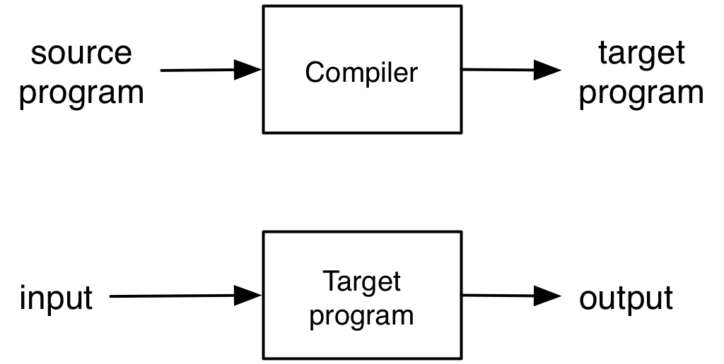

Compilation
def greet(s)
print("Hello, ”)
print(s)
print("!\n”)
end
11230452
23230456
01200312
…
“world”
“Hello, world!”
Source translated (compiled) to target language
Usually: target is machine code or bytecode
Also: high level interface code (JSON) to regular language

Slide 41
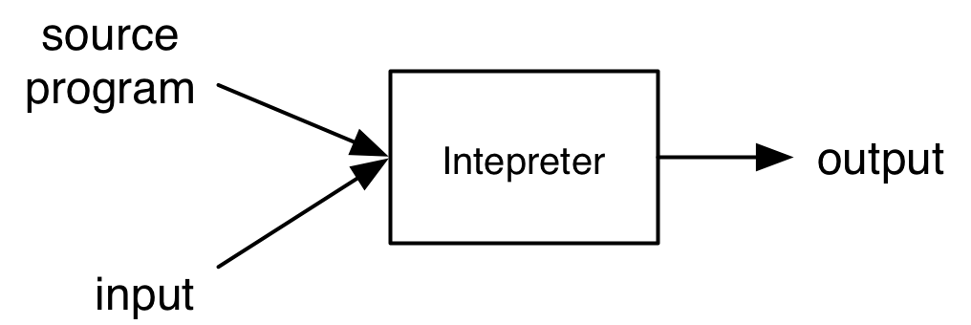
Interpretation
def greet(s)
print("Hello, ”)
print(s)
print("!\n”)
end
“Hello, world!”
“world”
Interpreter executes each instruction in source one at a time

Slide 42


Architecture of compilers, interpreters
Source
Parser
Static
Analyzer
Intermediate
Representation
Front End
Back End
Compiler / Interpreter

Slide 43
Front and Back Ends
Front ends handle syntax
Parser converts source code into intermediate format (“parse tree”) reflecting program structure
Static analyzer checks parse tree for errors (e.g., erroneous use of types), may also modify it
What goes into static analyzer is language-dependent!
Back ends handle semantics
Compiler: back end (“code generator”) translates intermediate representation into “object language”
Interpreter: back end executes intermediate representation directly

Slide 44
Compiler or Intepreter?
gcc
Compiler – C code translated to object code, executed directly on hardware (as a separate step)
javac
Compiler – Java source code translated to Java byte code
java
Interpreter – Java byte code executed by virtual machine
sh/csh/tcsh/bash
Interpreter – commands executed by shell program

Slide 45
Compiler or interpreter?
gcc
Compiler – C code translated to object code, executed directly on hardware (as a separate step)
javac
Compiler – Java source code translated to Java byte code
java
Interpreter – Java byte code executed by virtual machine
sh/csh/tcsh/bash
Interpreter – commands executed by shell program

Slide 46
How – schedule for this semester
Dynamic/ Scripting languages (Ruby) New languages
Functional programming (OCaml)
Scoping, type systems, parameter passing
Regular expressions & finite automata Language theory
Context-free grammars & parsing
Lambda Calculus
Safe, “zero-cost abstraction” programming (Rust) Safe programming
Secure programming

Slide 47
Workload
Tests
4 quizzes, 2 midterm exams, 1 final exam
Clicker quizzes
In class, graded, during the lectures
Projects
Project 1 – Ruby
Project 2-4 – OCaml (and parsing, automata)
Project 5 – Rust
Project 6 – Security

Slide 48
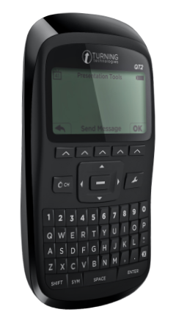
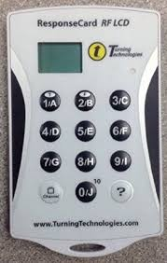
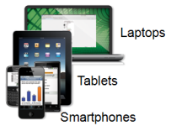
Clickers
Turning Technology clicker is required. Subscription is free. Phone app does not work.
You can get any of LCD, NXT, or QT2 models

Slide 49
Discussions
Discussion sections will deepen understanding of concepts introduced in lecture
Discussions are smaller, more interactive
Oftentimes discussion section will consist of programming exercises
Bring your laptop to discussion
Be prepared to program: install the language in question on your laptop, or remote shell into Grace
There will also be be quizzes, and some lecture material in discussion sections
Quizzes cover non-programming parts of the class

Slide 50
Program grading
You have accounts on the Grace cluster
Projects will be graded using the submit server
Software versions on these machines are canonical
Develop programs on your own machine
Generally results will be identical on Dept machines
Your responsibility to ensure programs run correctly on the grace cluster
See web page for Ruby, OCaml, etc. versions we use, if you want to install at home
Or install our Linux VM, which has them all

Slide 51
Semester advice
Use lecture notes as your text
Supplement with readings, Internet
You will be responsible for everything in the notes, even if it is not directly covered in class!
Keep ahead of your work
Get help as soon as you need it
Office hours, Piazza (email as a last resort)
Don’t disturb other students in class
Keep cell phones quiet
No distracting use of laptops

Slide 52
Academic Integrity
All written work (including projects) must be done on your own
Do not copy code from other students
Do not copy code from the web
Do not post your code on the web
Cheaters are caught by auto-comparing code
Work together on high-level project questions
Do not look at/describe another student’s code
If unsure, ask an instructor!
Work together on practice exam questions

Slide 53
Resources
Course web page
http://www.cs.umd.edu/class/fall2019/cmsc330/
Includes old exams and quizzes
Previous semesters are online with older powerpoints
Elms/Canvas
Recorded lectures
Some files, including outcomes with readings
Github
Projects

